Slide 1
E-retail factors for customer activation and retention: A case study from Indian e-commerce customers.

Slide 2
1. Problem Definition:
Many companies think that marketing is all about selling of products and how the company will increase its profitability in the market share and not considering after sales service to be able to know whether the customers are satisfied with the products are able to use it. The main problem is ‘what kind of strategies is expected from telecommunication industries to be able to retain their customers?’ Five major factors that contributed to the success of an e-commerce store have been identified as: service quality, system quality, information quality, trust and net benefit.

Slide 3
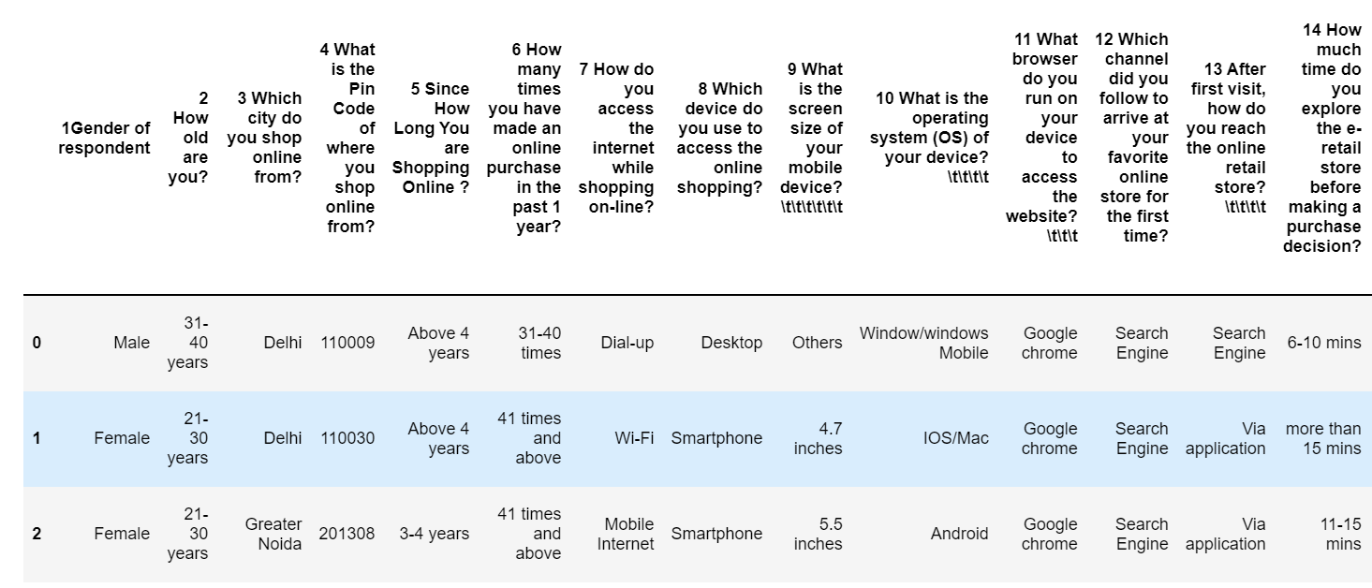
Dataset:

Slide 4
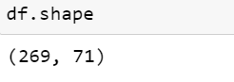
2. Data Analysis:
Check the how many Rows and Columns present in dataset:
Check the how much Columns and rows present in dataset using df.shape() is use to check the rows and columns count in this above dataset there are 269 rows and 71 columns are present.

Slide 5
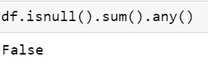
Check the null values present in dataset or not:
Using df.isnull().sum().any() is used to check any null values are present in dataset in above there was no null values are present in dataset.

Slide 6
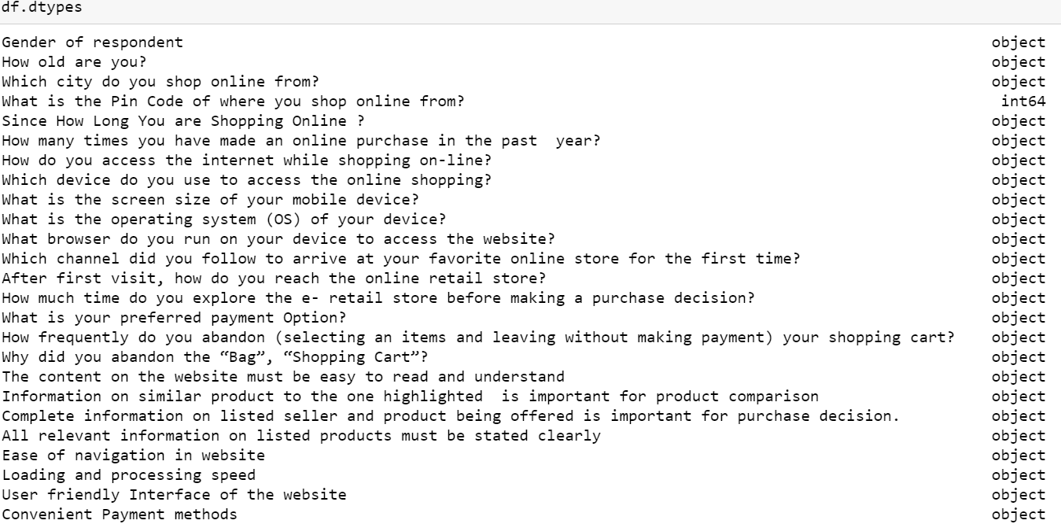
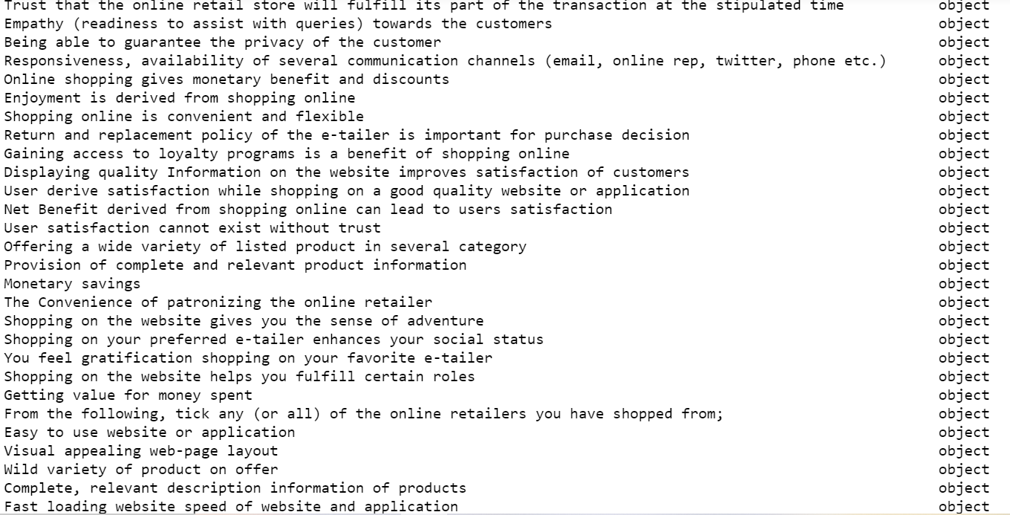
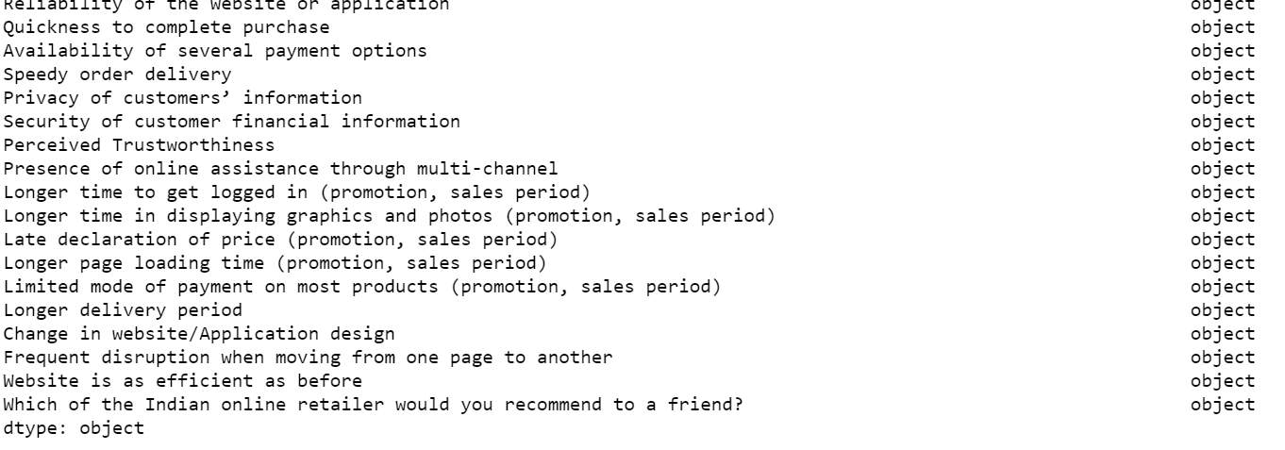
Here we check the datatypes of all the columns in dataset only one integer value are present and all are object values:

Slide 7
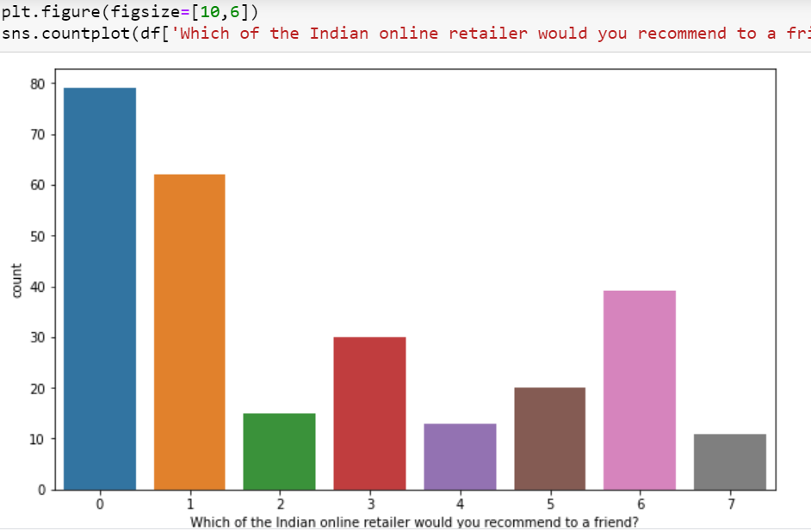
3. EDA:
Univarient Analysis:
In univarient analysis of above column is the target column in this column there was categorical values are present so it is classification problem and use classification algorithm there was class imbalance issue was occur so solve using Oversampling SMOTE is use to solve that problem.

Slide 8
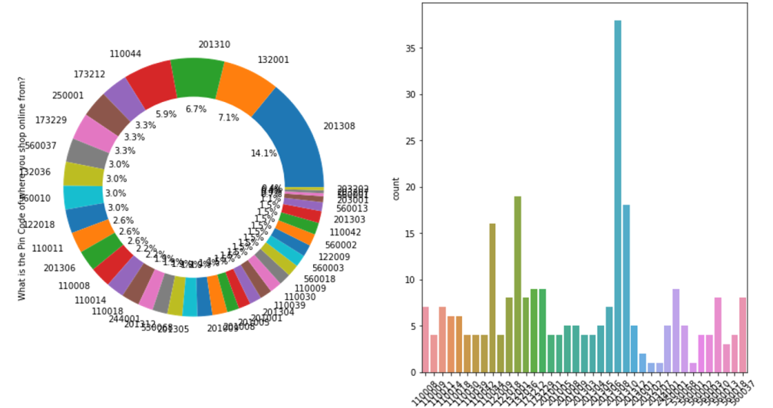
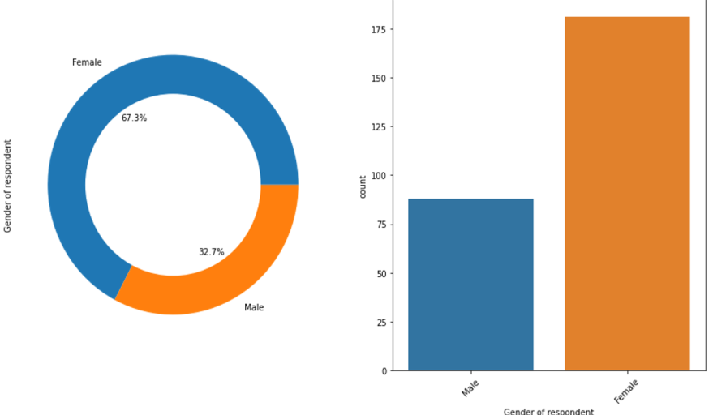
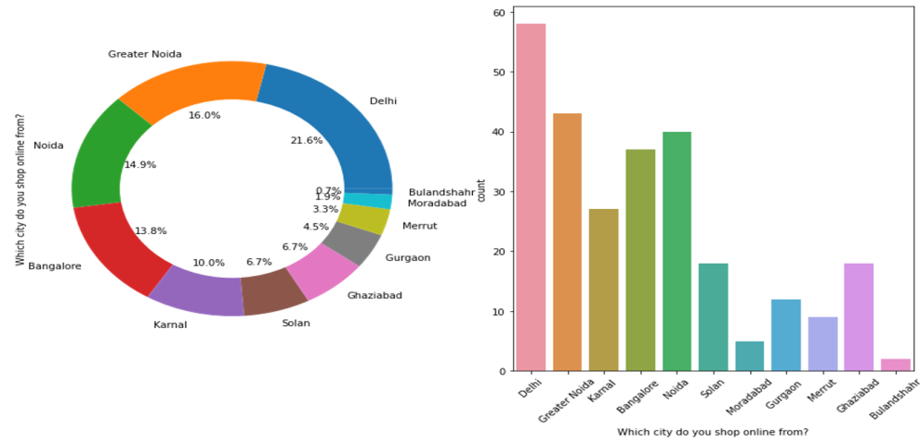
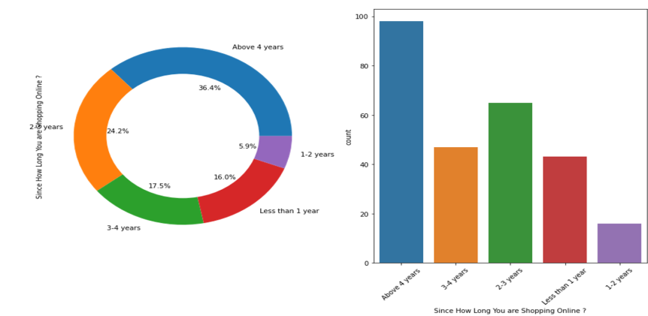
Above are the univarient analysis of the different columns

Slide 9
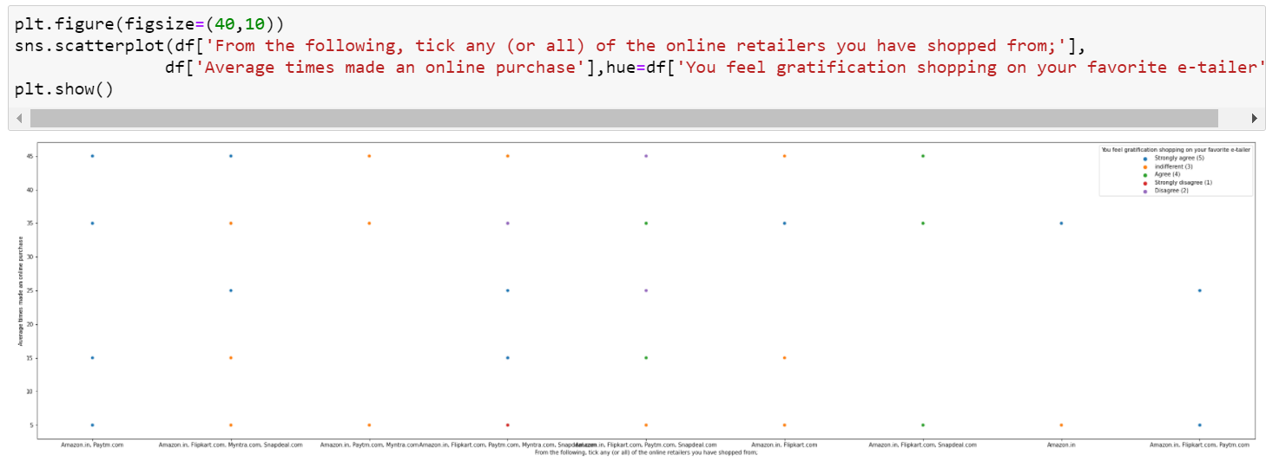
Bi varient Analysis:
Scatter Plot:
Here Above Scatterplot shows the comparison between two columns.

Slide 10
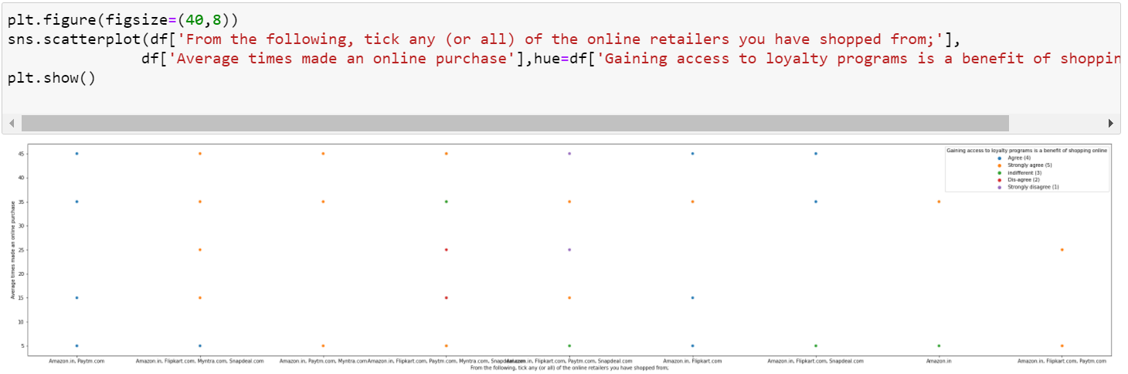
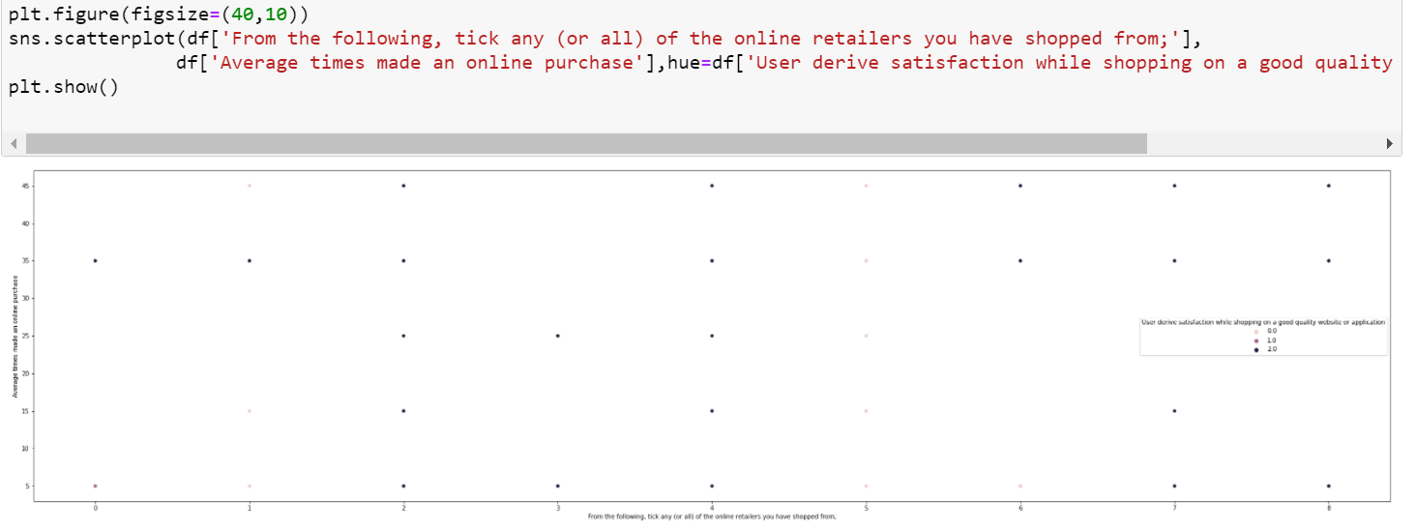

Slide 11
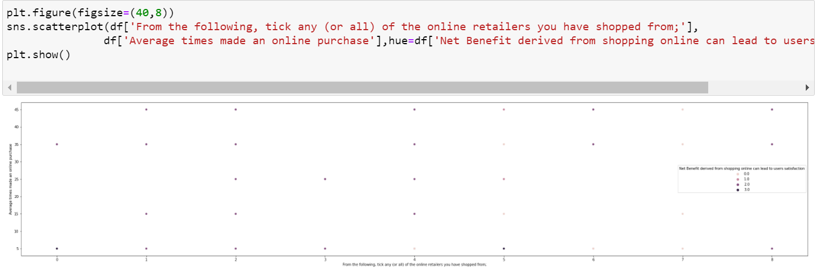

Slide 12
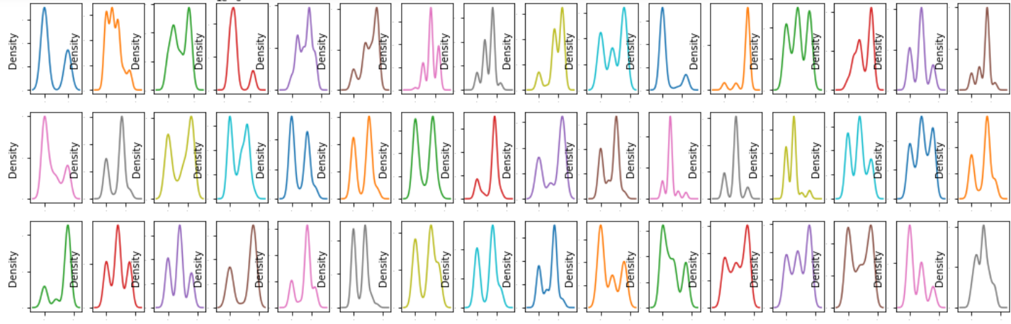
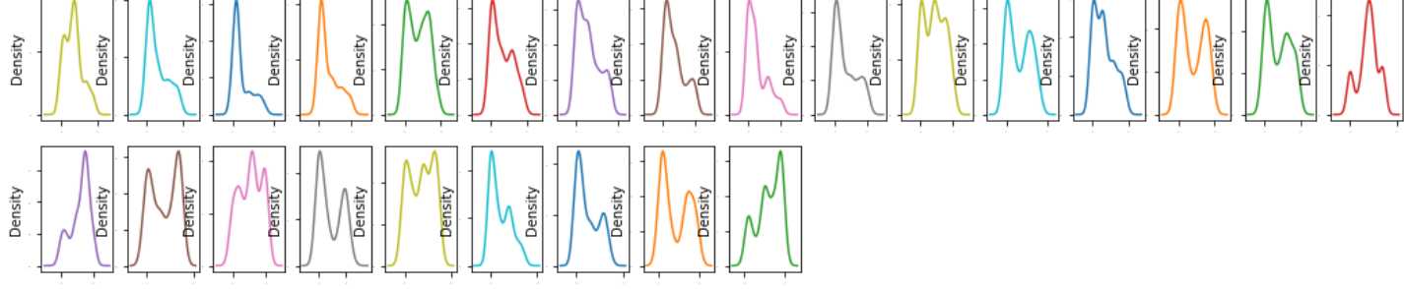
Multi Varient Analysis:
Above are the distribution of all the columns.

Slide 13
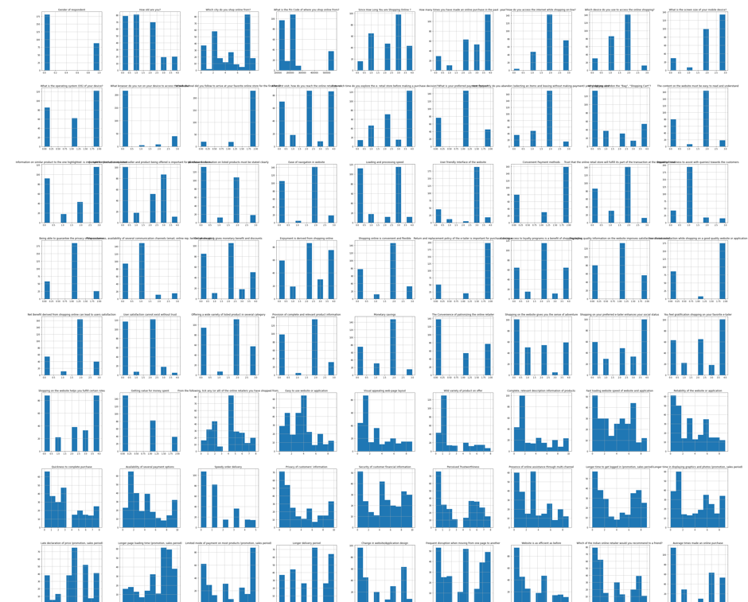
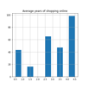
Histplot:
Above are the histplot of all the columns

Slide 14
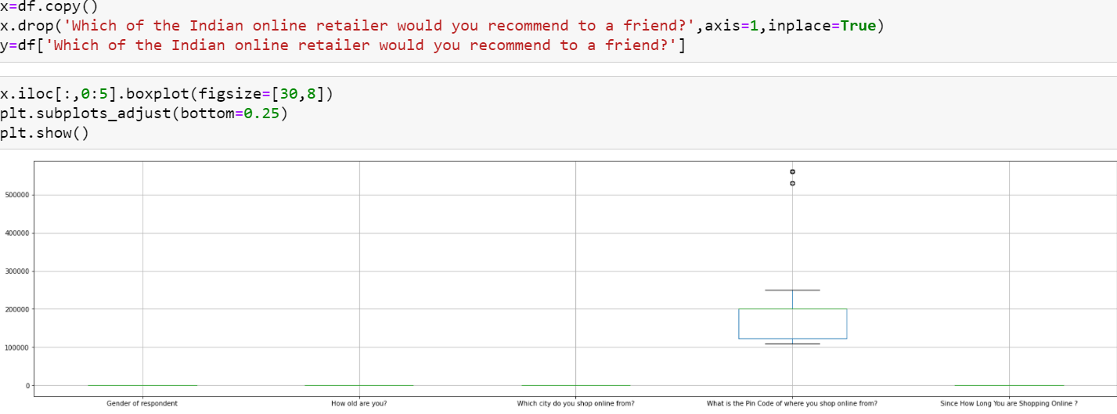
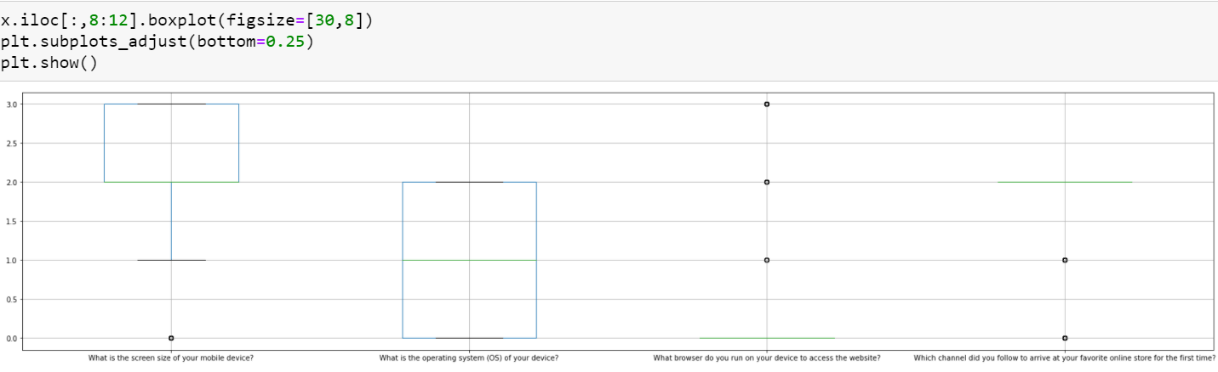
Checking Outliers:

Slide 15
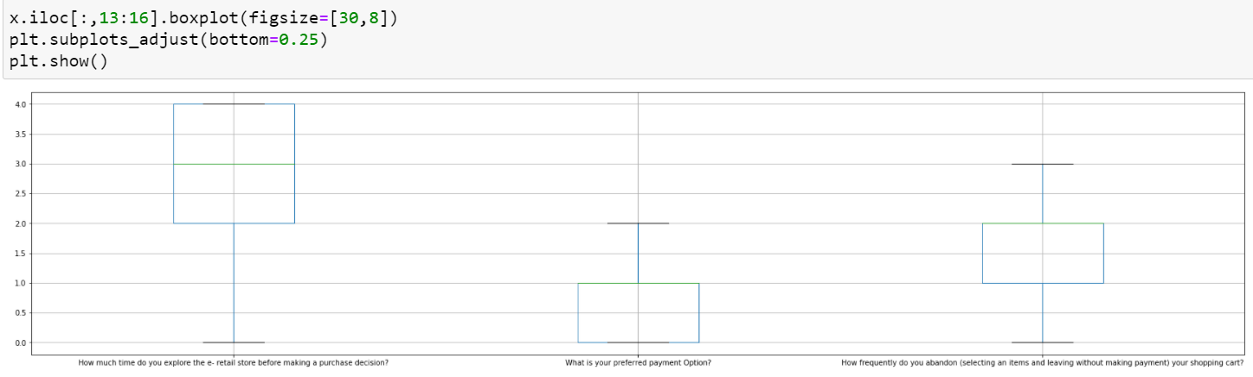
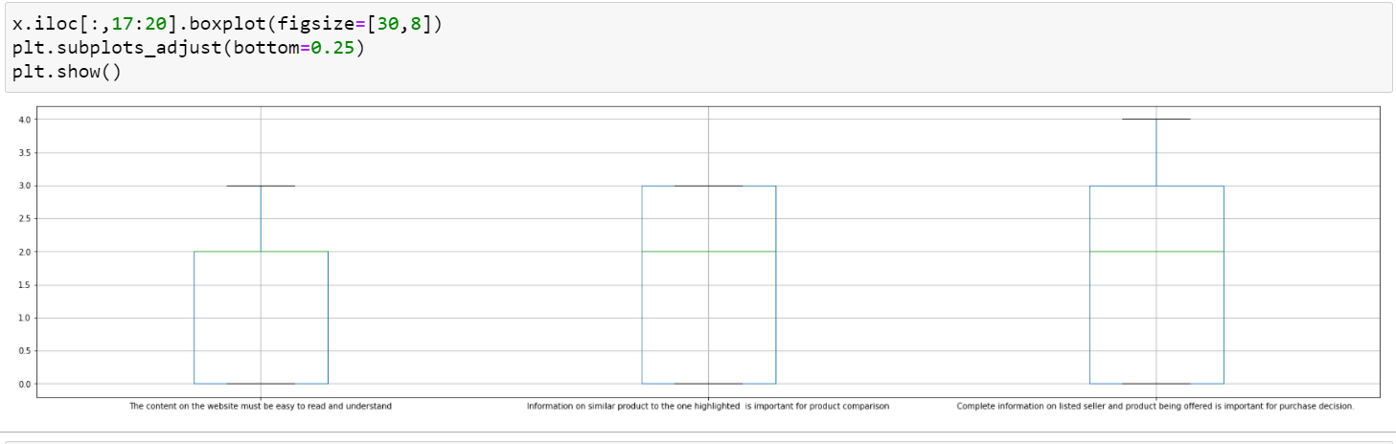

Slide 16
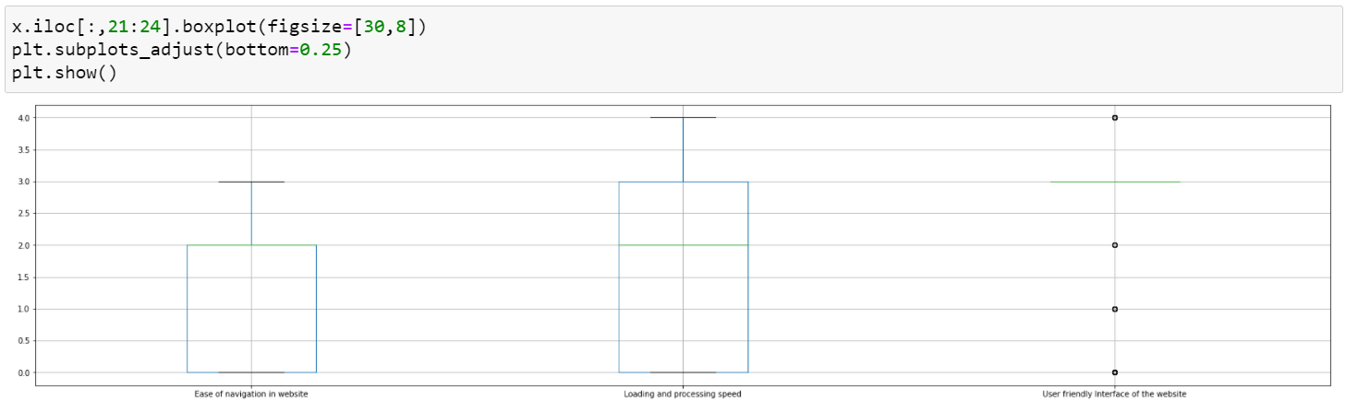
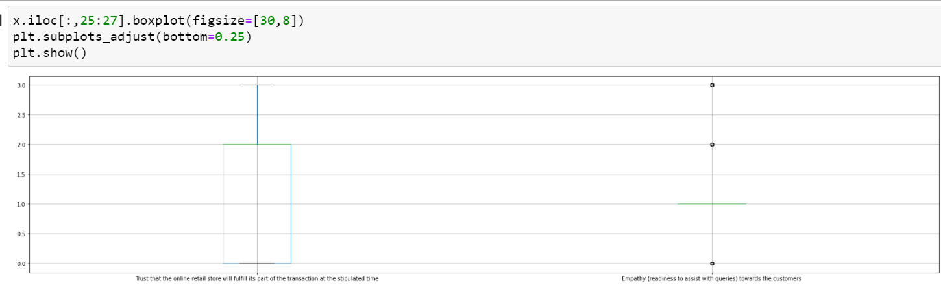

Slide 17
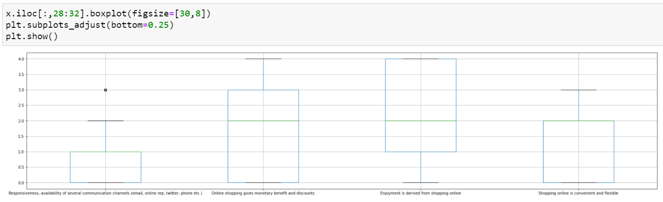
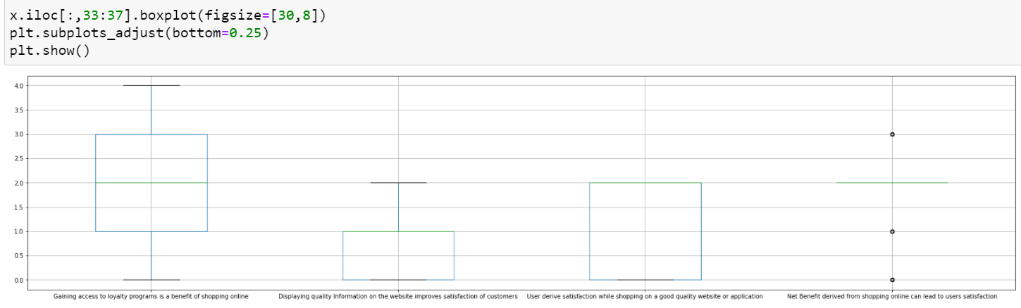

Slide 18
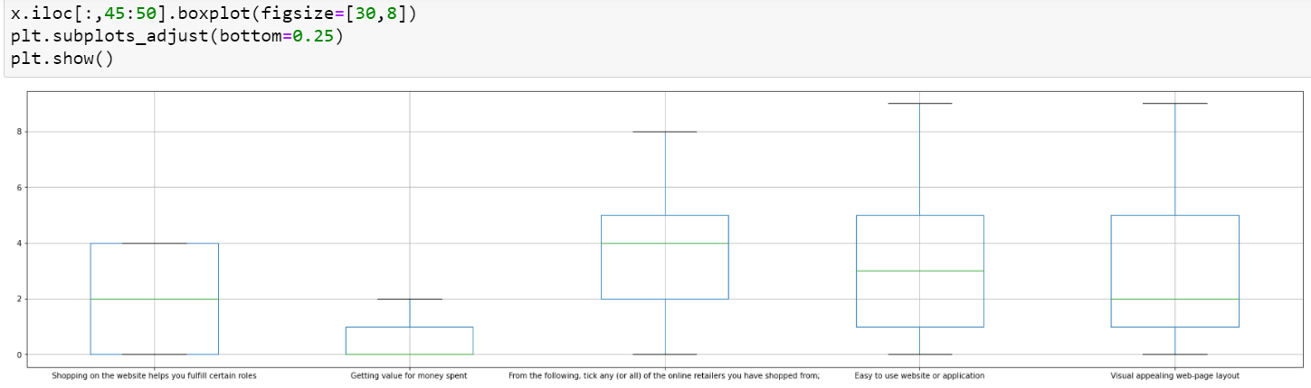
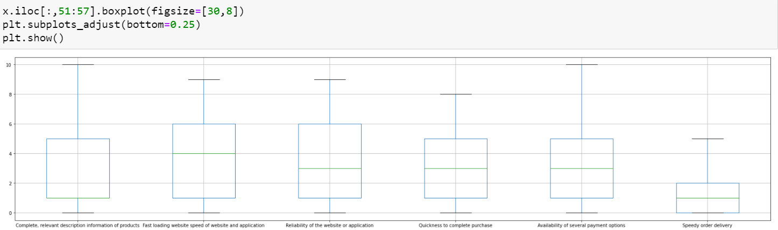

Slide 19
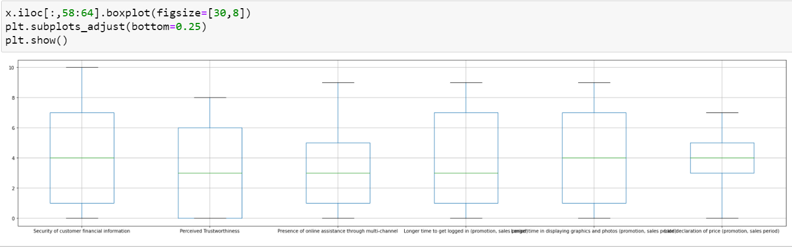
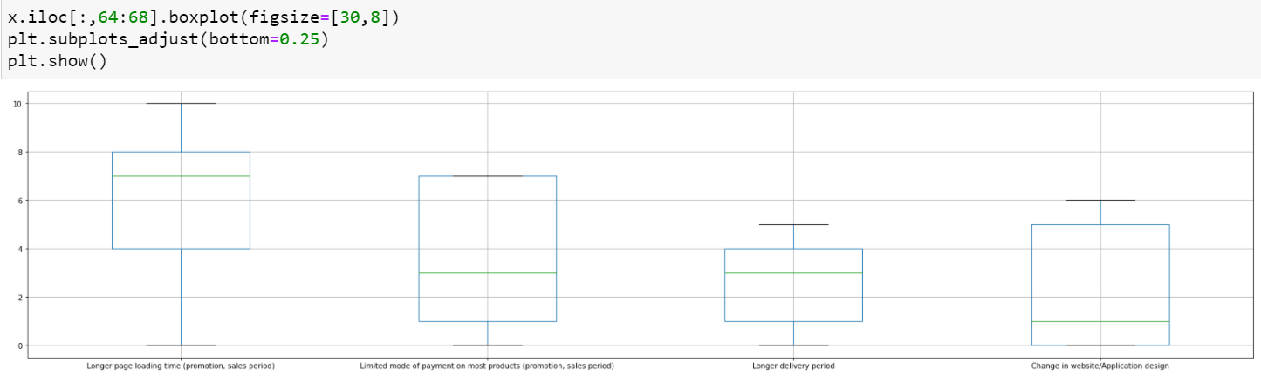

Slide 20
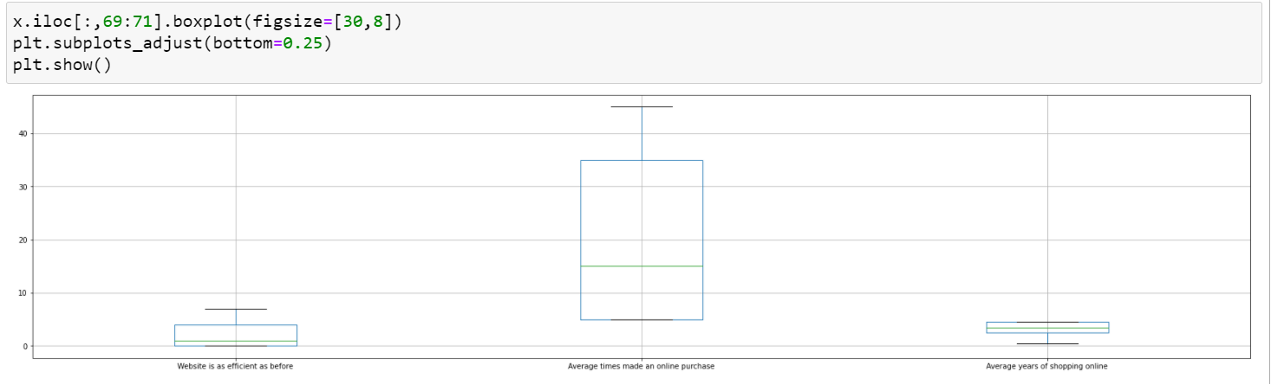
Here above many columns outlier was presents.

Slide 21
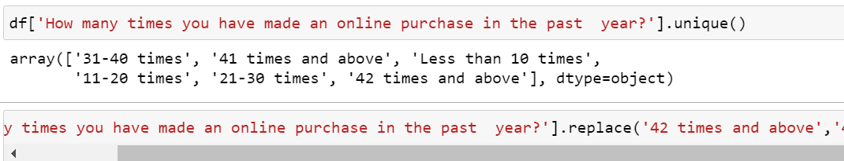
4. Preprocessing Steps:
Here in above ‘How many times you have made an online purchase in the past 1 year?’ Column count the unique values and replace some unique values.

Slide 22
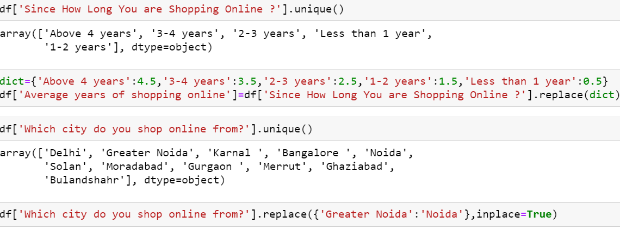
Here in above Since How Long You are Shopping Online ? in this Column replace the values with ‘Average years of shopping online’. And replace some values of ‘Which city do you shop online from?’column.

Slide 23
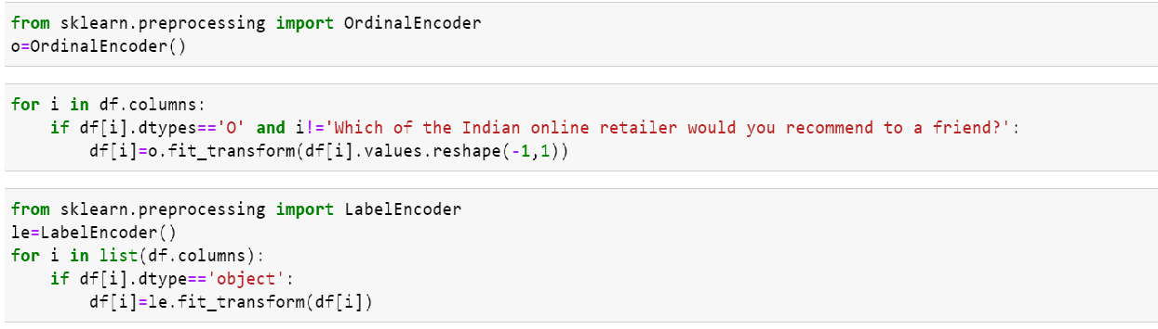
Encoding:
Here use Ordinal encoder and label encoder to replace the categorical values into numeric.

Slide 24
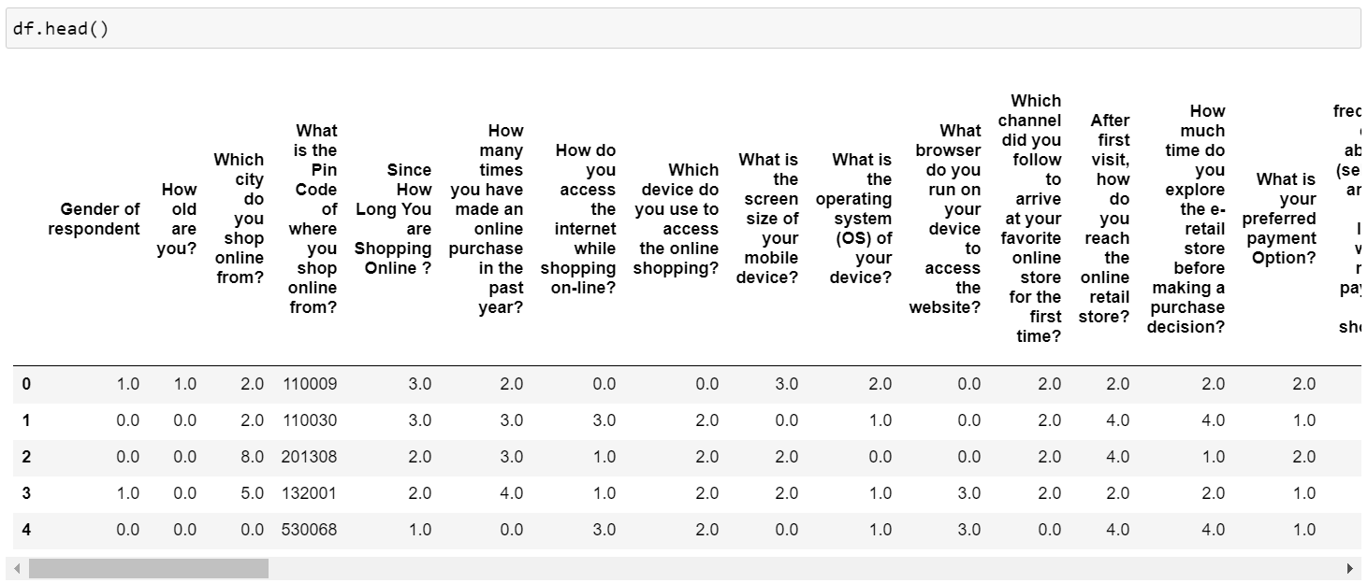
After converting categorical values into numeric using Lable encoder and Ordinal encoder then display dataset columns using df.head() here all all categorical values into numeric.

Slide 25
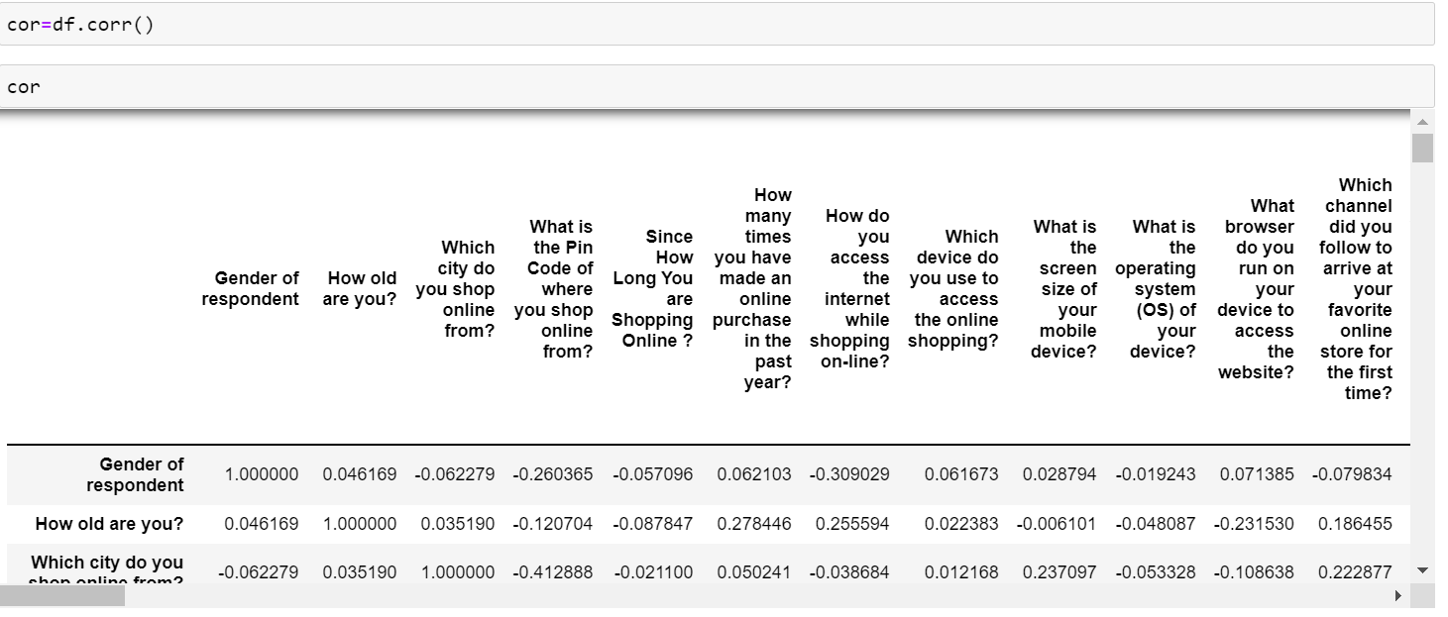
Correlation:

Slide 26
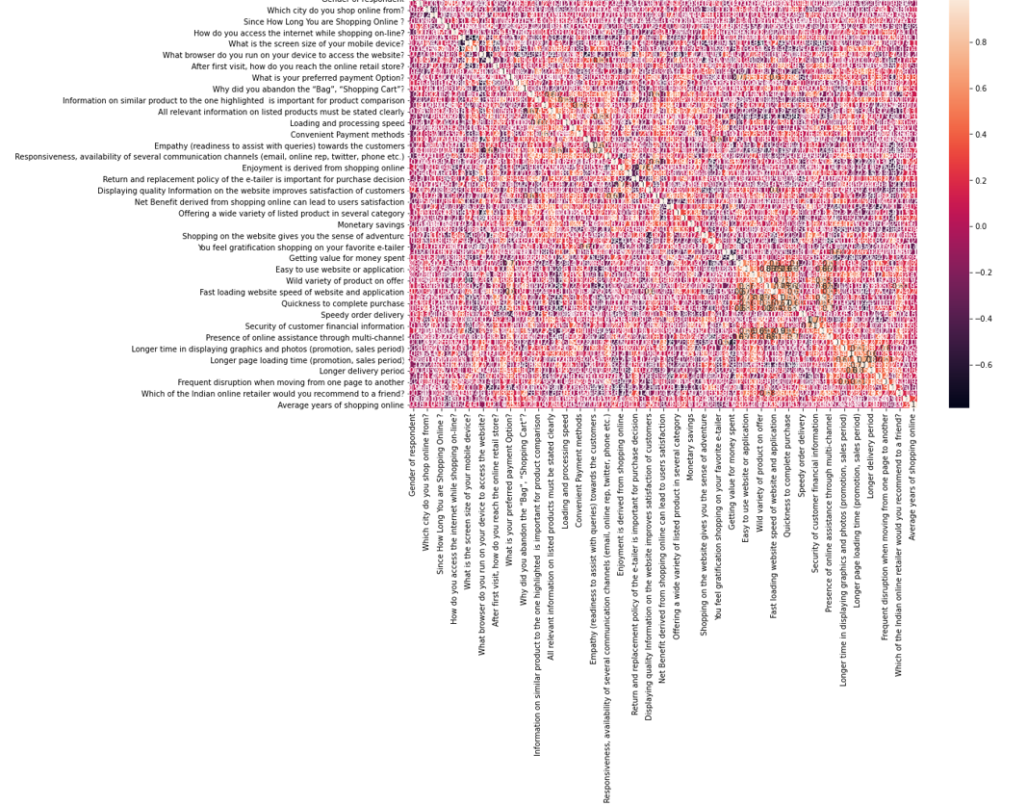
HeatMap:
In above heat map shows the correlation of all the independent variable with target variable.

Slide 27
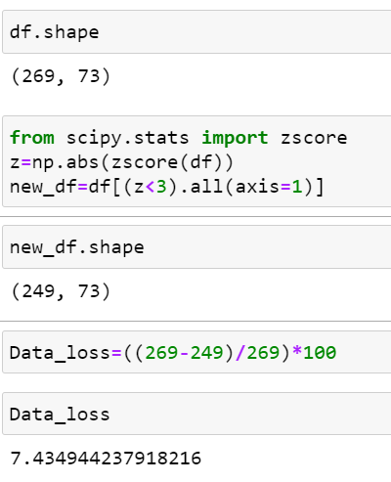
Use zScore Check the dataloss:
In this after using zScore 7.43 percent dataloss.

Slide 28
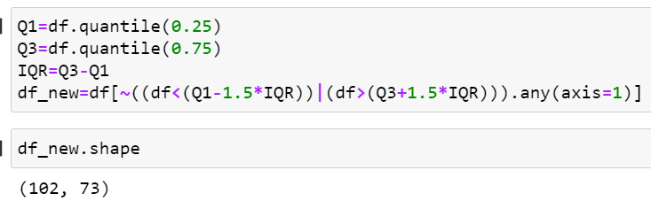
Use IQR Check the dataloss:
In this after using zScore and IQR methods using IQR more dataloss.

Slide 29
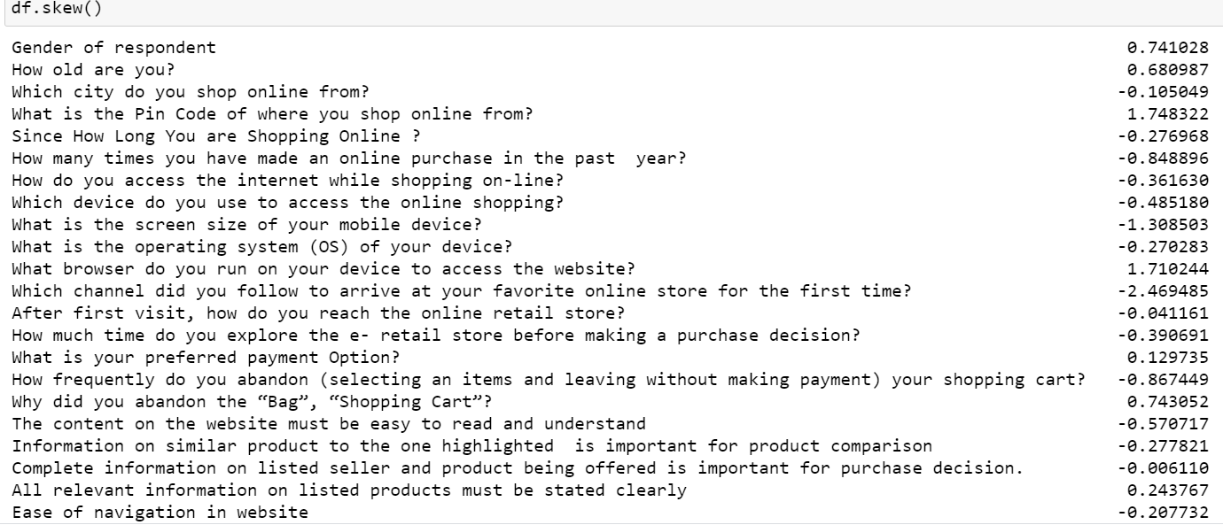
Checking Skewness:
Here many columns skewness are present to remove this skewness use different methods or techniques.

Slide 30
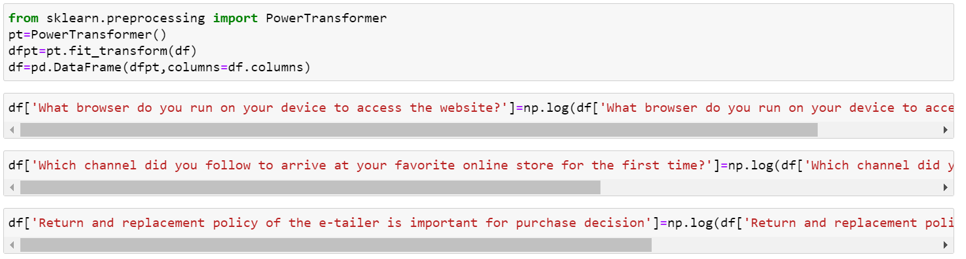
After use Power transform and log transform there was no skewness is present in dataset.

Slide 31
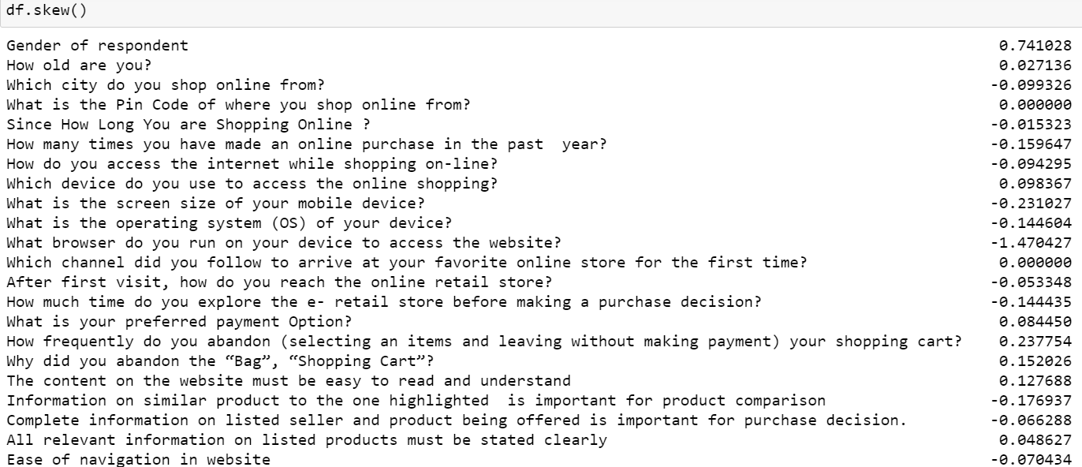
After using Power transform and log transform check the skewness there was no skewness is present indataset.

Slide 32
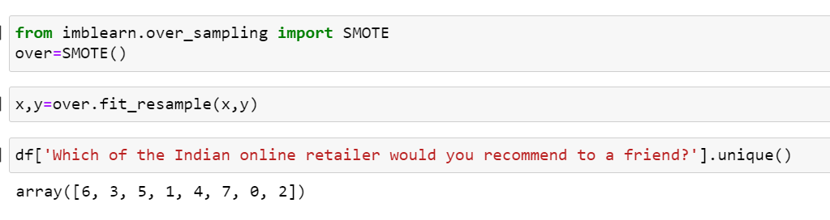
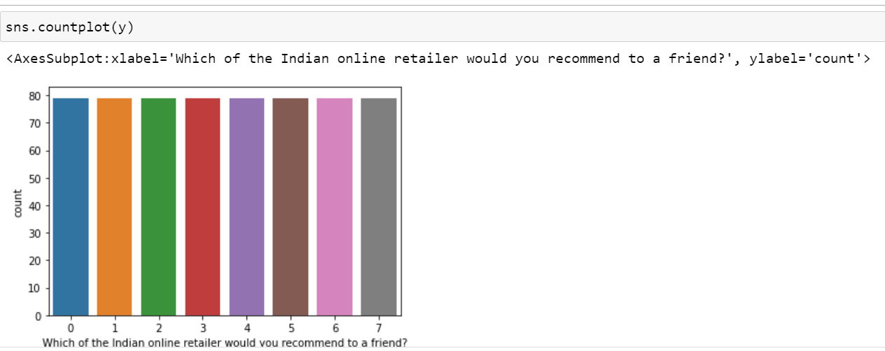
Oversamplig:
SMOTE:
After using Oversampling SMOTE now class are balance.

Slide 33
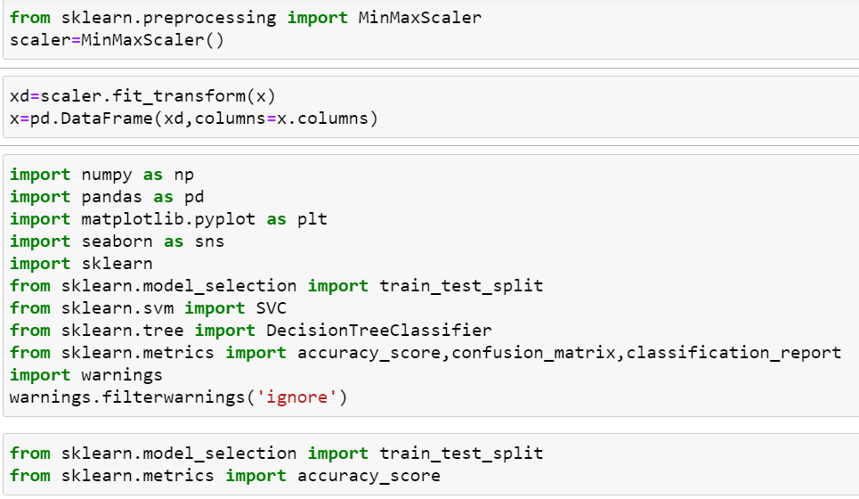
Min Max Scaler Technique:

Slide 34
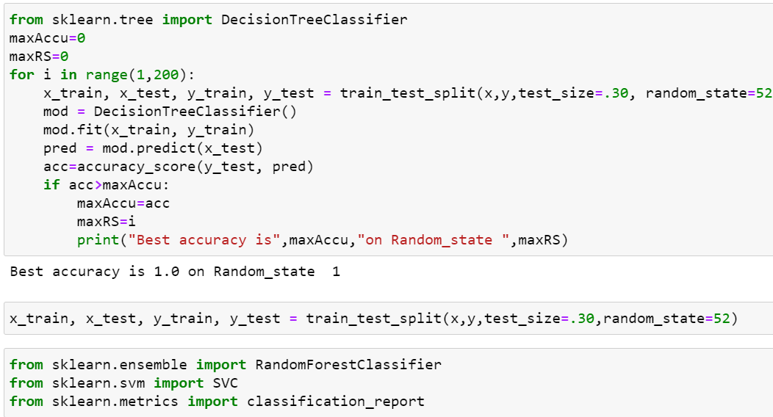
5.Building Machine Learning Models:
Decision Tree Classifier:

Slide 35
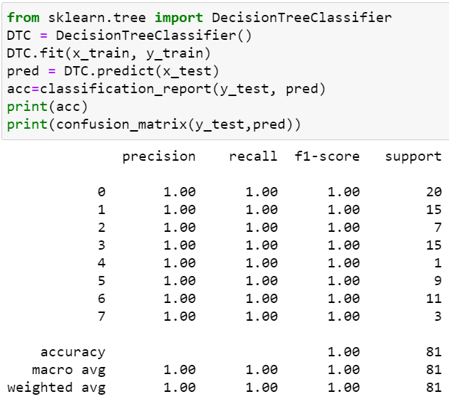
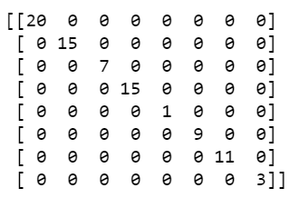
Here we use decision tree classifier model check accuracy score and confusion matrix of above accuracy score is 1.0.

Slide 36
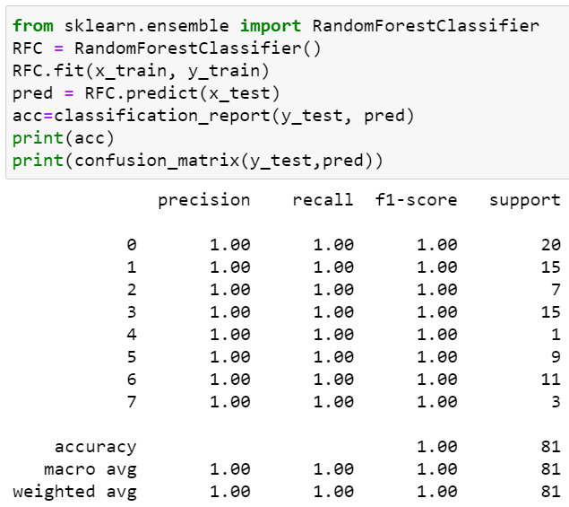

Random Forest Classifier:
Here we use Random Forest classifier model check accuracy score and confusion matrix of above accuracy score is 1.0.

Slide 37

Here we check accuracy score and after that check cross validation score of all the model the Random forest classifier is the best model because accuracy score and cross validation score is 1.0 So apply hyper parameter tuning on it.

Slide 38

GridSearchCv:
Here above are the parameter list of RandomForestClassifier model
The above code block we have the following parameters: max_features: In this maximum features there are two values auto and log2,sqrt. Criterion: In criterion there are two parameter values are present gini and entropy and n_estimator is 200 ,700 and in max_depth 4,5,6,7,8.

Slide 39


Slide 40

Here after use different parameter list the best parameter list is select.
Above are the best parameter list RandomForestClassifier.
Put this parameters into the model so output is finally best score RandomForestClassifier is 100 so it is the best score.

Slide 41


Finally load the model and predict the values.

Slide 42
6. Conclusion:
In this customer retention project Marketers can use the identified segments of online customers on the basis of their shopping values and decide accordingly on marketing strategies. Because customers satisfaction is most important.

